Slide 1


Python Web apI - Restful
Authorization / permissions

Slide 2
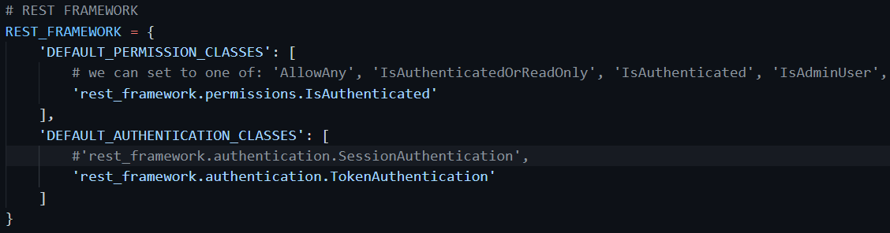
Permissions are set in different level
Project level default: in the settings.py

Slide 3
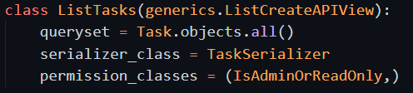
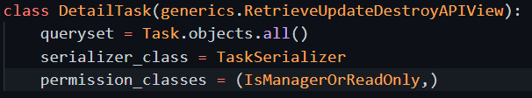
Views level permission
Can override this default in views level, or specific object level
The permission class is customized new class

Slide 4
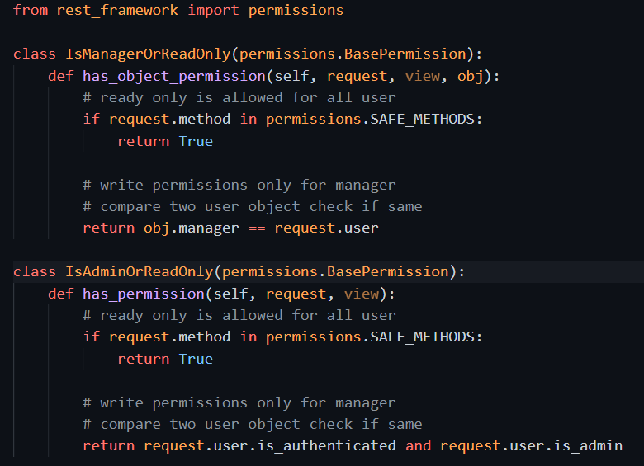
Permission class
Permission class need sub-class from BasePermission
The ListCreateView only allow admin to create new todo task
The RetrieveUpdateDeleteView only allow the object manager to do data change. (refer to model definition about manager field)

Slide 5
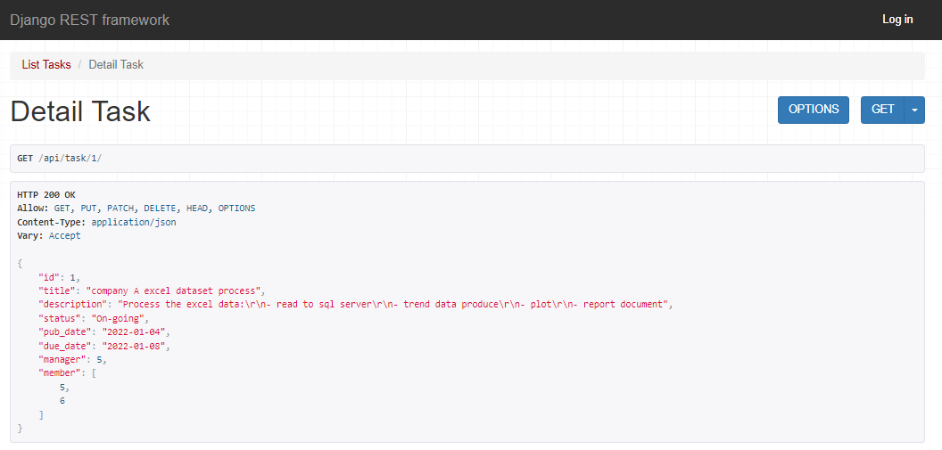
Check the permission with browser
Even not login user, can view the data.
Because now view gives readonly by default to any user. This override the project level default IsAuthenticated behavior.

Slide 6
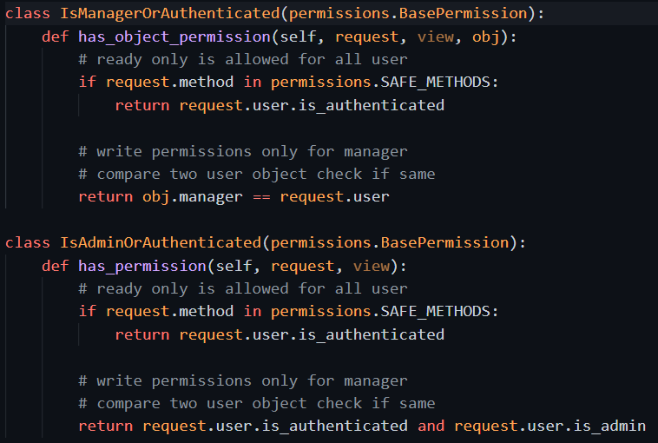
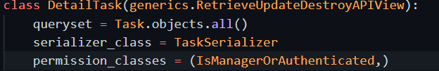
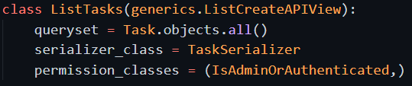
Change the permission of view, require to be authenticated

Slide 7
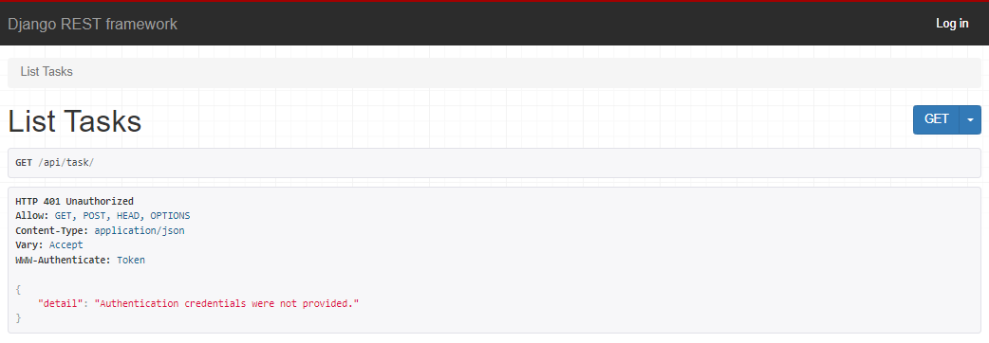
Check using browser: cannot get data
It is the new view level permission denied the request.

Slide 8
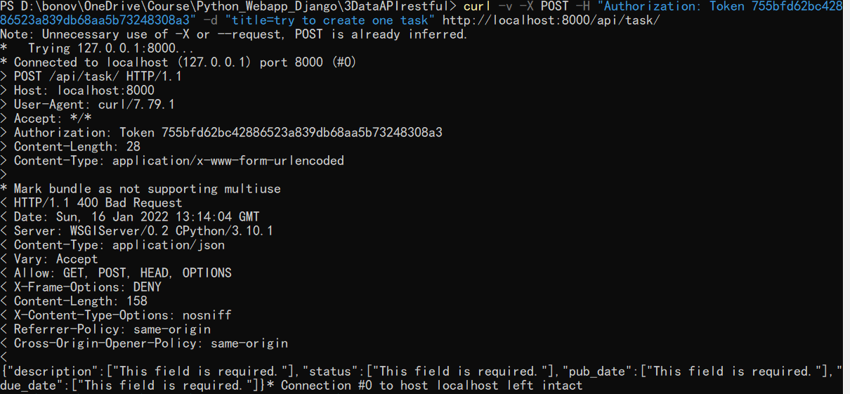
User curl to provide token
Because with browser we cannot add authorization header. So need use curl to add it and check. Follow request passed authorization, only request missing data.

Slide 9
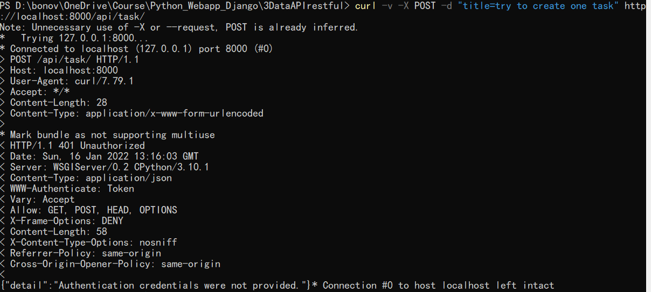
If with no token

Slide 10
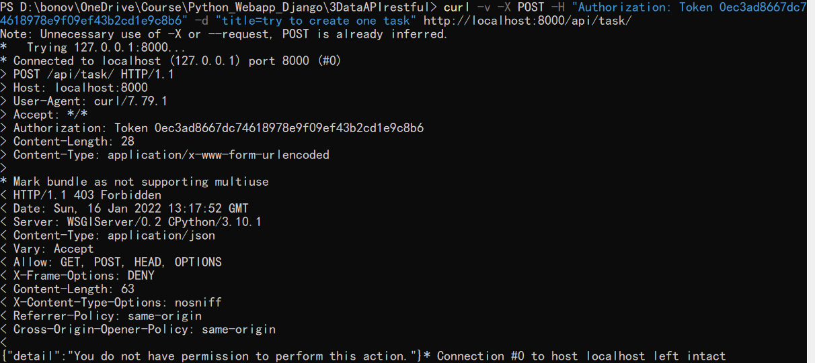
Or using token for another not authorized user (no create permission)

